Slide 1


Department of Artificial Intelligence and Data Science
Group Members:
Tushar Chavhan
Sakshi Ingale
Vrushali Dhage
Snehal Godage
Roll No.23 Roll No.28 Roll No. 30
Roll No. 49
Under The Guidance of : Prof. Sonam Singh
A.Y.2025-26

Slide 2
Introduction to the Problem Domain
Rapid urbanization → insufficient drainage infrastructure.
Increasing rainfall events due to climate change.
Cities like Pimpri-Chinchwad, Mumbai, Chennai face frequent waterlogging.
Impact: Traffic disruption, property damage, health risks, and economic loss.
AI relevance: Predictive modeling, real-time monitoring, and adaptive management.
Dr. D. Y. Patil Institute of Technology | Artificial Intelligence and Data Science
2

Slide 3
Problem statement
Urban areas face frequent waterlogging due to intense rainfall and inadequate drainage capacity.
Existing systems are reactive – flooding is addressed only after it occurs.
Lack of real-time monitoring and predictive analysis makes early warning difficult.
Current research mainly focuses on rainfall prediction or static flood mapping, not on drainage performance and preventive measures.
There is a need for an AI-driven solution that combines prediction + real-time monitoring + preventive action to reduce waterlogging risks.
3

Slide 4
Aim & Objectives:
Develop an AI-based predictive model for waterlogging risks.
Integrate IoT sensors (water level, rainfall, flow rate) for real-time monitoring.
Provide early warnings to municipal authorities and citizens.
Suggest data-driven improvements in drainage design and maintenance.
Reduce socio-economic impacts of urban flooding.
Dr. D. Y. Patil Institute of Technology | Artificial Intelligence and Data Science
4

Slide 5
Literature Review (Existing methods):
Year of Publication | Authors | Method | Results / Achievements | Limitations/Gap
2024 | Japan Case Study | IoT + AI pumps/sluice | 90% accuracy, faster pump response | Costly, limited scalability
2025 | K. Haripriya et al | AI + IoT (RF, CNN, SVM, LoRaWAN) | RF 92%, alerts in 4.2s, 38% cost cut | Simulation-based, high setup cost
2024 | S. Veerappan | Edge IoT + LSTM (Raspberry Pi) | 92.4% accuracy, <300 ms latency | Small pilot, memory limits
2024 | U.K. Sharma & A. Maurya | Review of ML in drainage | Identified ML benefits (LSTM, RL best) | No experiments, deployment gap
2024 | T. P. S. Thanigaivelu et al. | IoT + AdaBoost | 2–3 hr early warning, reduced flooding | Pilot only, weak for complex floods
Dr. D. Y. Patil Institute of Technology | Artificial Intelligence and Data Science
5

Slide 6
Comparative Analysis :
Aspect | Past Research Works | Proposed Work
Focus Area | Mainly on rainfall prediction or flood risk mapping | Comprehensive: rainfall + drainage monitoring + preventive actions
Data Sources | Rainfall data, satellite images, GIS maps | Rainfall + IoT drain sensors (water level, flow rate) + historical waterlogging records
Technology Used | Machine Learning models (Regression, Random Forest, LSTM), GIS mapping | AI/ML (LSTM, anomaly detection) + IoT integration + Cloud-based dashboard
Real-Time Monitoring | Mostly absent or limited to rainfall | Continuous real-time monitoring of drainage and rainfall
Output/Results | Static maps, alerts, or prediction graphs | Actionable insights: waterlogging risk alerts, early warnings, and maintenance recommendations
Scalability | Applied in small pilot areas or case studies | Designed as a scalable smart city solution with cost-effective deployment
Limitations | High infra cost, no preventive maintenance link, reactive approach | Bridges prediction & prevention, focuses on affordable and adaptive solutions

Slide 7
Proposed Methodology :
1)Data Collection
Historical rainfall & flood records
Real-time IoT sensors (water level, flow, rainfall)
2)Data Processing
Cleaning & feature engineering
Integration with GIS maps
3)AI/ML Modeling
LSTM / ML models for rainfall–runoff prediction
Classification models for waterlogging risk
4)Decision Engine
Early warnings & alerts
Preventive maintenance suggestions
5)Dashboard & Alerts
Real-time monitoring dashboard
SMS/Email/Push notifications to authorities & citizens
6)Deployment & Feedback
Pilot testing in selected urban areas
Continuous improvement with new data

Slide 8
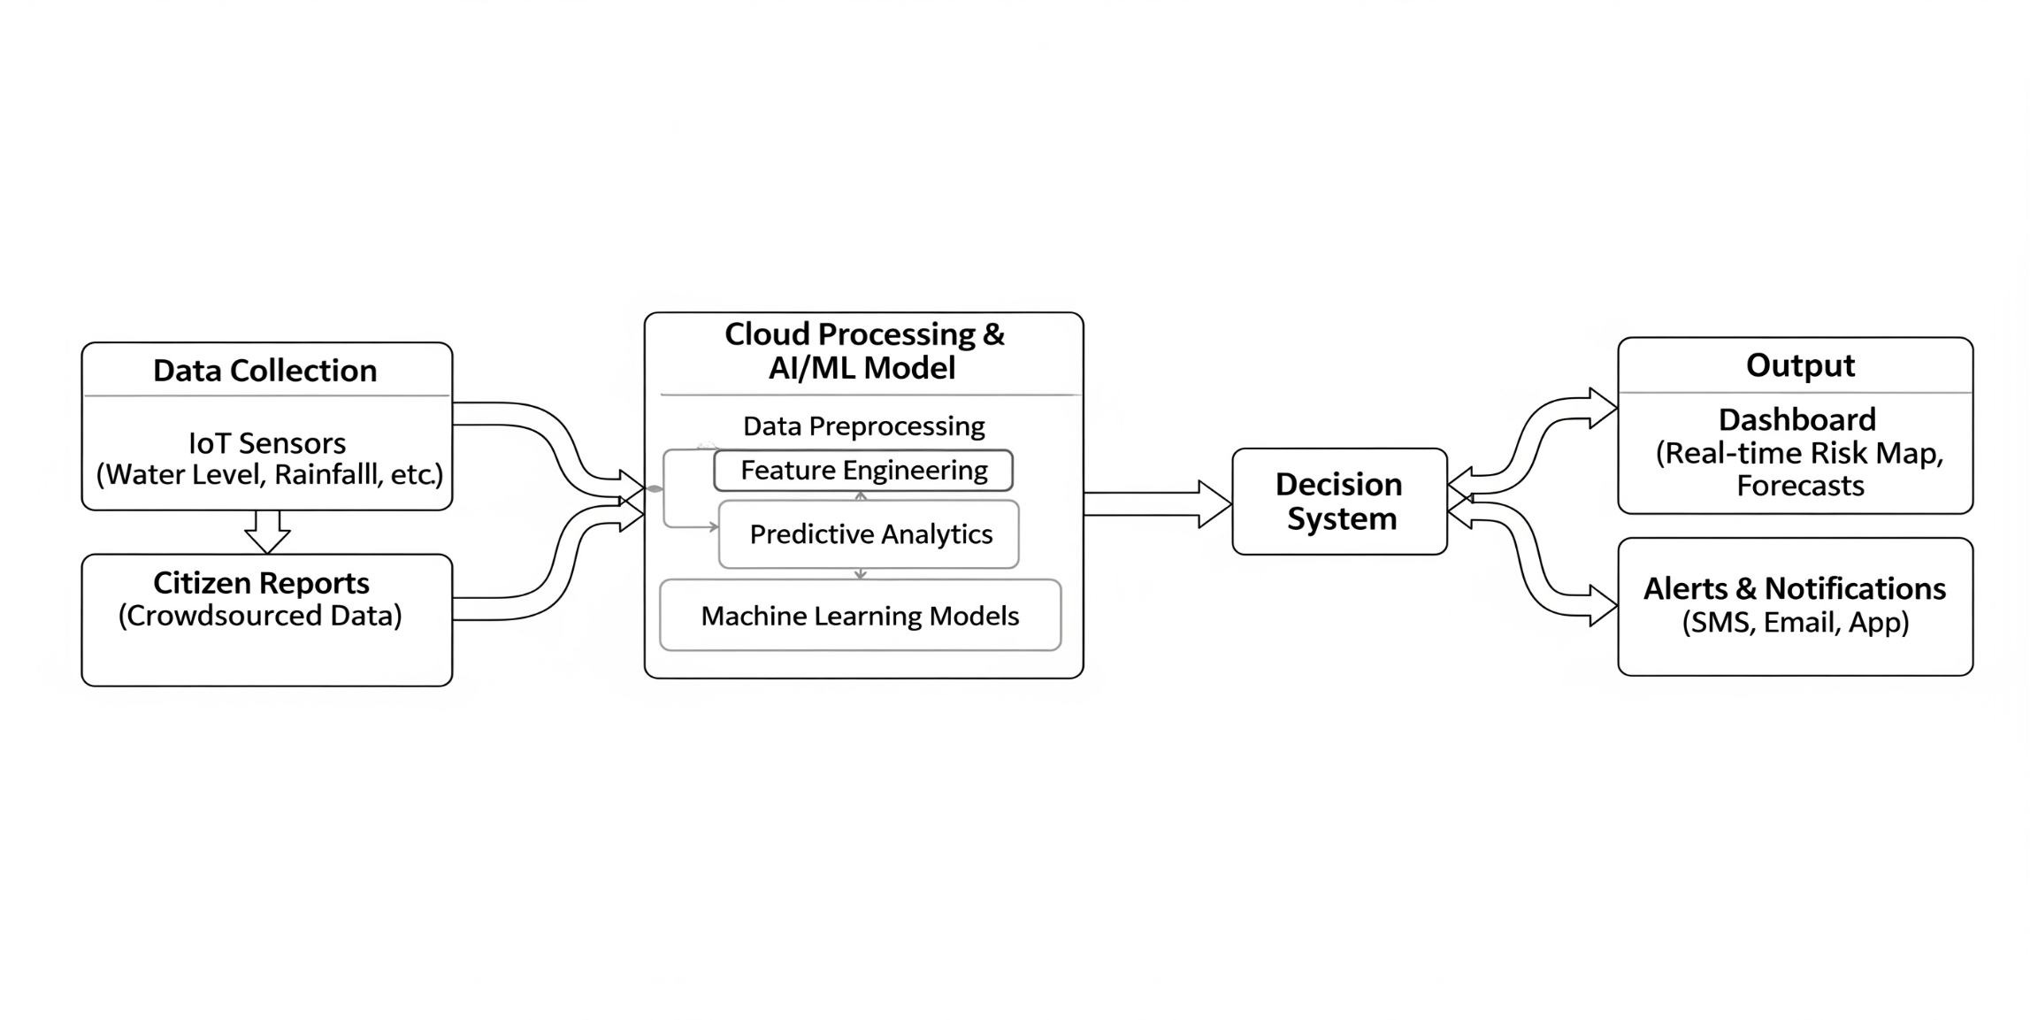
Block Diagram:

Slide 9
Motivation :
Increasing urban flooding due to climate change & unplanned growth.
Existing solutions focus only on rainfall prediction / flood maps – limited real-time action.
Drainage systems today are reactive, not preventive.
AI + IoT can enable real-time monitoring & early warnings.
Our project bridges prediction and prevention, supporting smart city resilience.

Slide 10
References
Sharma, R., & Gupta, A. (2022). IoT-based water level monitoring system for urban flood prevention. International Journal of Smart Infrastructure, 10(3), 45–52.
Li, Y., & Wang, J. (2023). Rainfall-runoff prediction using deep learning models in urban drainage systems. Journal of Hydrology, 617, 128912.
Patel, K., Deshmukh, S., & Rao, M. (2024). AI and GIS integration for flood risk mapping in Indian smart cities. Sustainable Water Management, 12(2), 77–86.
Government of India, Ministry of Housing & Urban Affairs. (2023). Smart Cities Mission: Urban Flood Management Report.
World Bank. (2021). Climate Resilient Urban Flood Management Practices.

Slide 11

Thank You
engg.dypvp.edu.in |

